Slide 1
Eco system
Presented by
Banu manthi.s
Gana.L

Slide 2
Contents
Introduction and definition
Structures and functions of eco system
Food chain
Food web
Ecological pyramid

Slide 3
Definition of Ecosystem
An ecosystem can be defined as composite of biotic and abiotic components and species that interact among themselves and co exist in a region .

Slide 4

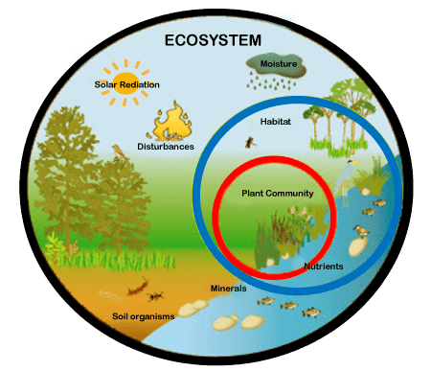

Slide 5
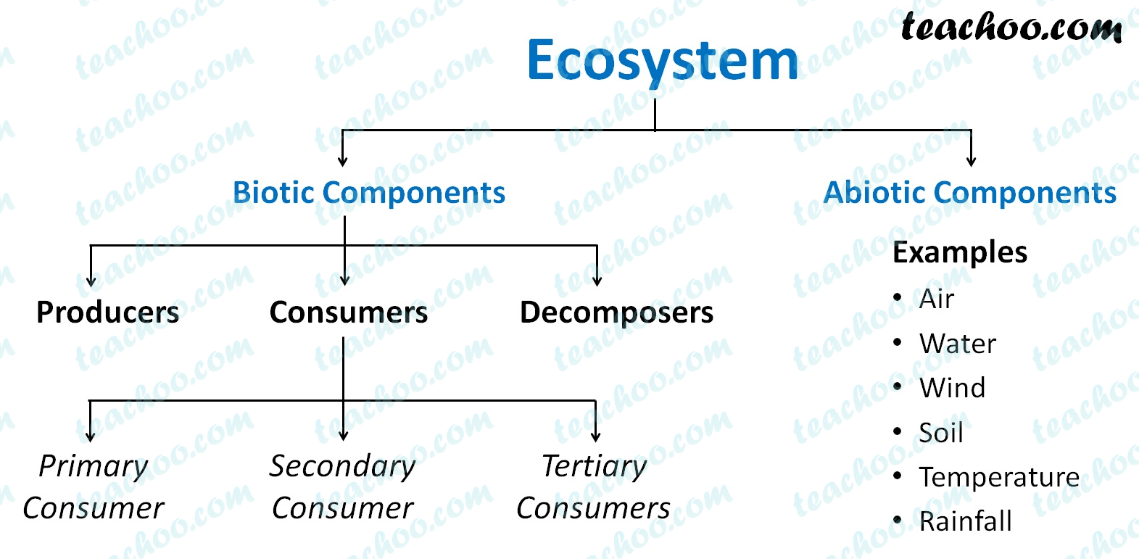
Components of ecosystem

Slide 6
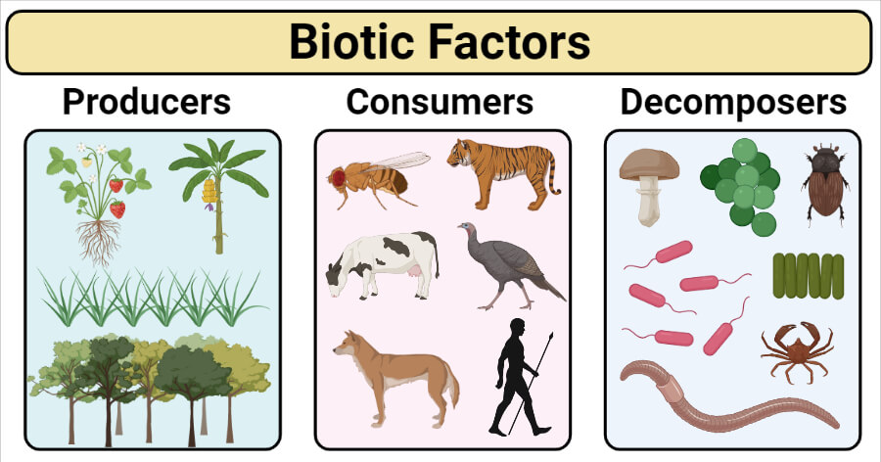
Biotic components

Slide 7
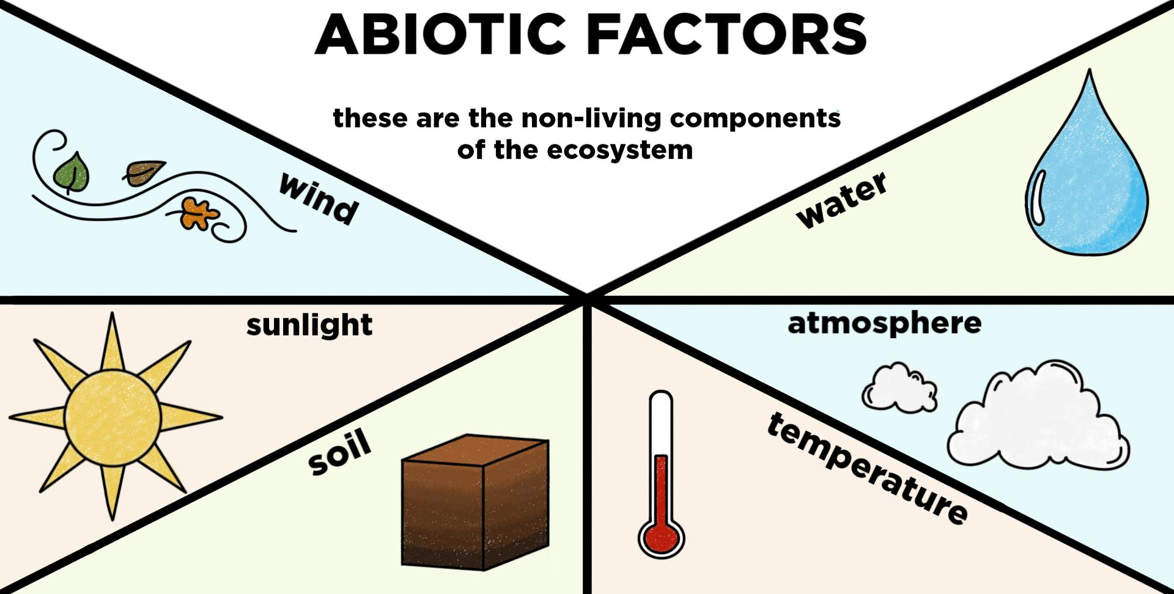
Abiotic components

Slide 8
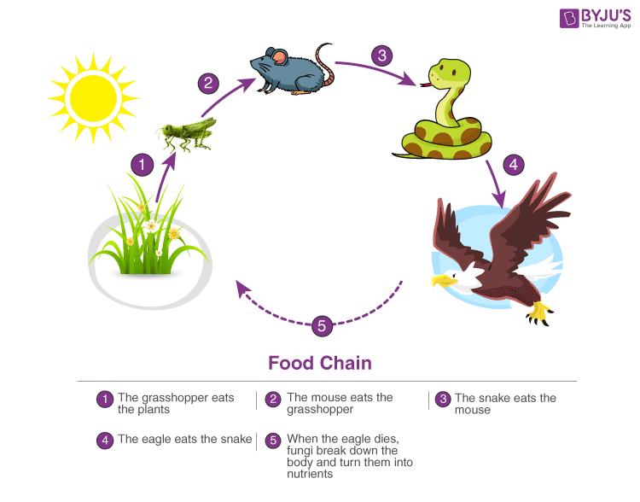
Food chain

Slide 9
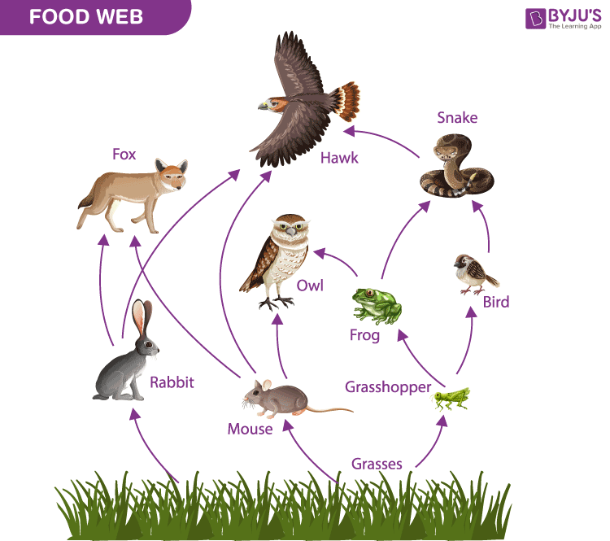
Food web

Slide 10
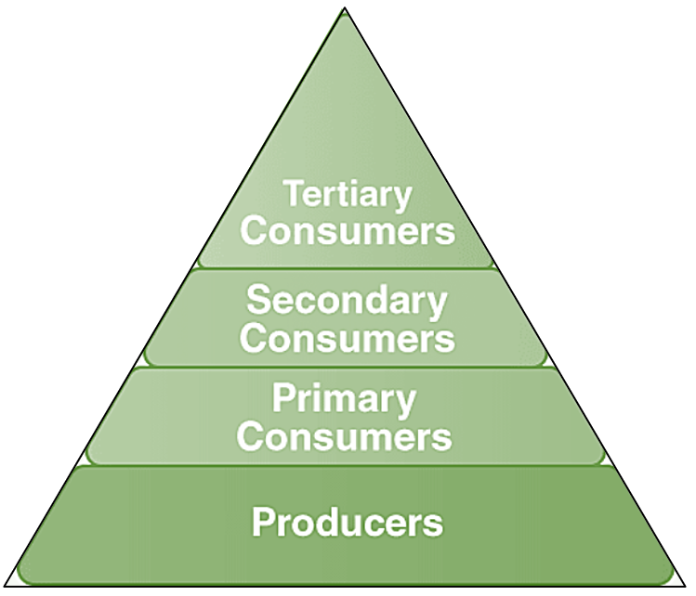
Ecological pyramid

Slide 11
Thank you

